Slide 1
Technical Support (420-1N6-AB) Customizing Windows & Introduction to unattended installations
Fall 2023

Slide 2
Outline
Post OS Installation steps:
Update OS
Install drivers
Install apps
Remove apps
Enable/Disable Telemetry
Unattended Installation of Windows:
Introduction to the Assignment 4
Audit Mode
Answer file
Sysprep
Windows Image File (.wim)

Slide 3
After OS Installation – What is next?
What should be done after finishing an OS installation?
Install \ Update Device Drivers (if needed)
Network cards driver: to be able to connect to the network/internet.
Update computer operational information:
Set the correct Date, Time and time zone.
Provide a proper name for the computer.
Security:
Install security software: Antivirus
Update OS: install patches, service packs.
Setup firewall.
Install required software applications.

Slide 4
Updates to OS and applications
A service pack is a collection of updates, fixes or enhancements to a software program, delivered in the form of a single installable package. They may introduce new features to an OS as well as bug fixes, security enhancements, etc.
It is common to have service packs issued within the first two years of release of a product, and they are usually numbered, e.g. SP1, SP2.
Note: Microsoft recommends that you never be more than two service packs behind.

Slide 5
Using Powershell to install Apps
Now that you have internet on the VM you can use it to update your drivers and install apps.
We’ve already seen how to install CPU-Z and drivers by downloading the .exe and running the installer.
Let’s see how to use Powershell and a package installer called winget to install multiple apps with a single command.
The winget command line tool enables users to discover, install, upgrade, remove and configure applications on Windows 10 and Windows 11 computers. This tool is the client interface to the Windows Package Manager service.

Slide 6
Activity: Installing apps using winget
Select the apps you most commonly use, here are a few useful ones: https://winstall.app/
Open Powershell and type: winget install –id <AppId> && winget install –id <AppId2> && ..
App | App Id
7 zip | winget install --id=7zip.7zip
CPU-Z | winget install --id=cpuid.cpu-z
VLC Player | winget install --id=VideoLAN.VLC
Adobe Acrobat Reader | winget install --id=Adobe.Acrobat.Reader.32bi
Notepad ++ | winget install --id=Notepad++.Notepad++
Zoom | winget install --id=Zoom.Zoom
MS Office | winget install --id=Microsoft.Office -e

Slide 7
Example of a command
winget install --id=7zip.7zip -e &&
winget install --id=cpuid.cpu-z -e &&
winget install --id=Google.Chrome -e &&7
winget install --id=VideoLAN.VLC -e &&
winget install --id=Adobe.Acrobat.Reader.32-bit -e &&
winget install --id=Notepad++.Notepad++-e &&
winget install --id=Zoom.Zoom –e

Slide 8
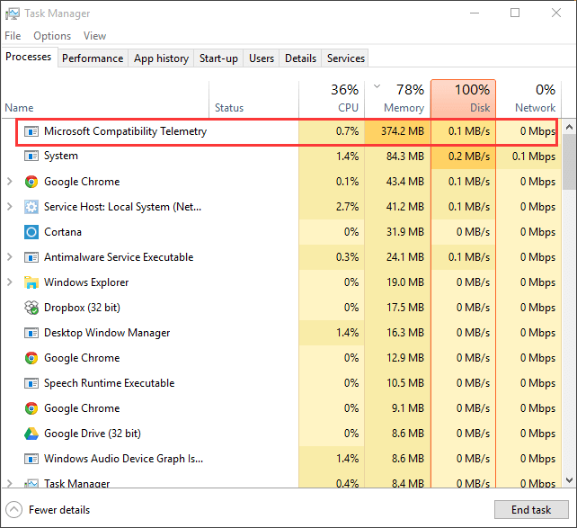
Windows Telemetry
Windows 10 and Windows 11 collect information about how people use computers for future enhancements of the user experience.
For example: Handwriting, voice sampling, etc.
The Telemetry process may occupy a lot of CPU ressources.

Slide 9
Windows Telemetry
If you don’t want the OS sending data to Microsoft’s telemetry servers you can disable both the telemetry and the data collection with the following commands”
sc delete DiagTrack
sc delete dmwappushservice
echo ““ > C:\ProgramData\Microsoft\Diagnosis\ETLLogs\AutoLogger\AutoLogger-DiagTrack-Listener.etl
REG ADD "HKLM\SOFTWARE\Policies\Microsoft\Windows\DataCollection" /v AllowTelemetry /t REG_DWORD /d 0 /f

Slide 10
Windows Built-in apps
Windows comes with a wide range of pre-installed apps
Many of those apps you will not use and they will simply be occupying space on your hard drive.
If you wish to remove them follow the step 5 in this tutorial: https://theitbros.com/sysprep-windows-machine/
What if we needed to repeat the same exact steps on 1000 machines in a college?

Slide 11
Technical Support (420-1N6-AB) Unattended Installation – Assignment 4
Fall 2023

Slide 12
Installation Types
Standard Installation
Administrator sitting at the machine answers a series of questions.
Suitable for a small number of computers.
Unattended Installation
Uses an installation file called Autounattend.xml which stores the answers.
Windows will check for USB devices with this file in its root directory.
Suitable for large number of computers.
Details:
https://docs.microsoft.com/en-us/windows-hardware/manufacture/desktop/automate-windows-setup

Slide 13
Unattended Installation
Allows us to automate the OOBE (out-of-box-experience) steps (choosing language, create a user, create a password, install apps, remove unused apps)
Very convenient if you need to install the same exact system on many machines.
It’s also useful if you use VMs and would like to keep a personalized version of Windows with you on a USB key with all your favorite apps.

Slide 14
Windows Deployment Services (WDS)
This is a role available for Windows Server 2008 which allows for automatic deployment of operating system images to computers with PXE-compliant network adapters.
The WDS transmits the operating system to all computers configured to receive it and starts installation.
PXE = Pre-Boot Execution Environment, component of Intel’s WfM specification which allows a workstation to boot from a server.
A PXE-enabled workstation connects its NIC to the LAN via a jumper which keeps the workstation connected to the network even when the power is off. To be considered “compliant”, the PXE must be supported by the NIC and the BIOS.

Slide 15
Assignment 4 - Logistics
Assignment 4 Instructions:
Teams 2-3
Done in P-326 (Most of it done in class)
Worth 18%
Unattended Installation of Windows
Generalize iso file to deploy on multiple machines
Create the iso file and deploy it on a VM (demo to the teacher)
The steps are prone to errors!

Slide 16
Assignment 4 – Major Steps
1) Preparing a Windows 11 VM on Hyper-V
2) Getting into Windows 11 Audit Mode
3) Installing Windows ADK
4) Customize user profile of the PC based on requirements
5) Create answer file
6) Running Sysprep
7) Saving the custom Windows Image File (.wim)
8) Creating the custom .ISO file
9) Deploying the ISO on new VMS

Slide 17
OOBE vs Audit Mode
When you install Windows there’s two main options:
Out-of-Box Experience (OOBE) – What you have used so far in this course:
Right after the installation of Windows, you are asked to create a user account with a password, set the language of the system, the time and date, etc…
Audit Mode:
This is a general mode of windows (without a personal email or account) which logs you in with a built-in administrator account.
To open the audit mode, you must press CTRL + SHFT + F3

Slide 18
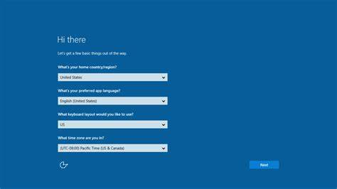
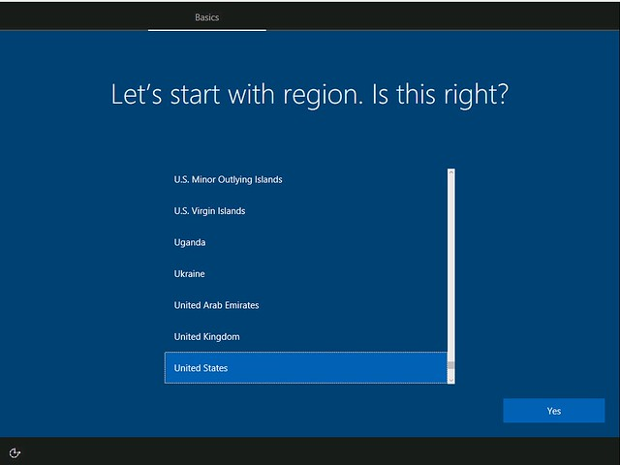
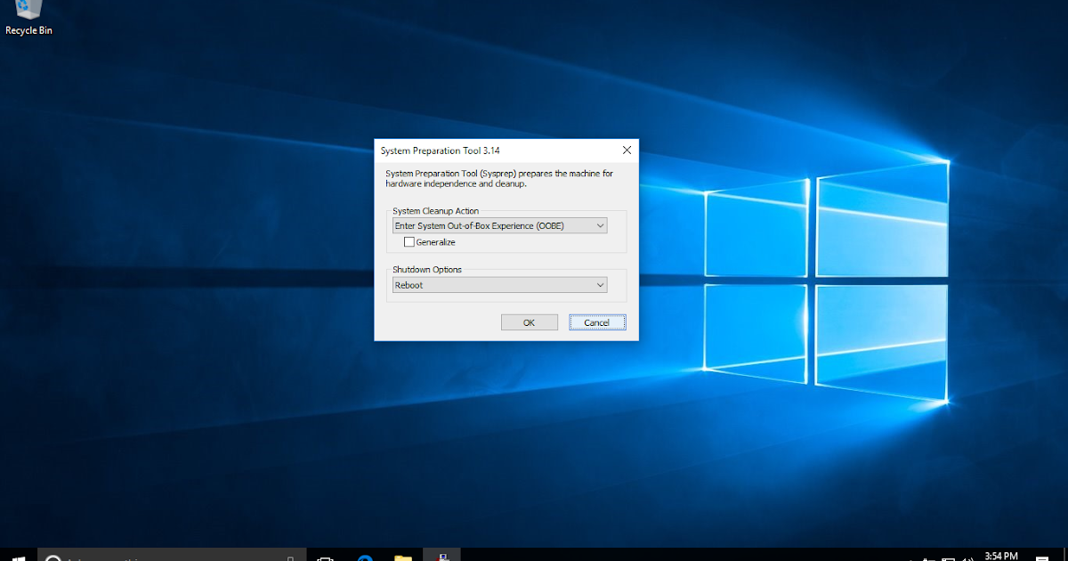
After an installation of Windows
OOBE
Next
Audit Mode
CTRL + SHFT + F3
OOBE Screen

Slide 19
Audit Mode
This little menu is the GUI for Sysprep
We will use Powershell or CMD

Slide 20
SysPrep
SysPrep stands for System Preparation “Generalization” tool.
It takes the current configuration and customization of your machine to produce an .iso file that can be installed on other machines.
SysPrep will remove computer-specific information such as drivers and the computer security identifier (SID).
There’s two ways of using sysprep:
By itself
Unattend Answer

Slide 21
How to run SysPrep
After personalizing the PC to your liking in Audit mode and creating the unattend file, we will “generalize” the current windows
Through a CMD opened as admin:
C:/Windows/system32\sysprep\sysprep.exe /generalize /reboot /oobe /unattend:d:\unattend.xml
This means it can be deployed to other machines, otherwise this image will be only for this PC.

Slide 22
How to run SysPrep
After personalizing the PC to your liking in Audit mode and creating the unattend file, we will “generalize” the current windows
Through a CMD opened as admin:
C:/Windows/system32\sysprep\sysprep.exe /generalize /reboot /oobe /unattend:d:\unattend.xml
This means that the computer will reboot after running sysprep

Slide 23
How to run SysPrep
After personalizing the PC to your liking in Audit mode and creating the unattend file, we will “generalize” the current windows
Through a CMD opened as admin:
C:/Windows/system32\sysprep\sysprep.exe /generalize /reboot /oobe /unattend:d:\unattend.xml
This means that the computer will start in oobe mode after the reboot

Slide 24
How to run SysPrep
After personalizing the PC to your liking in Audit mode and creating the unattend file, we will “generalize” the current windows
Through a CMD opened as admin:
C:/Windows/system32\sysprep\sysprep.exe /generalize /reboot /oobe /unattend:<path to the file>:\unattend.xml
This means “use specifically this unattended xml script to create the windows image”… this contains the users, passwords, apps ,etc all the personalization

Slide 25
Answer file – or unattended.xml
It’s an XML file which specifies the various setup options, includes:
How to partitions disks
Where to find the Windows image.
The product key.

Slide 26
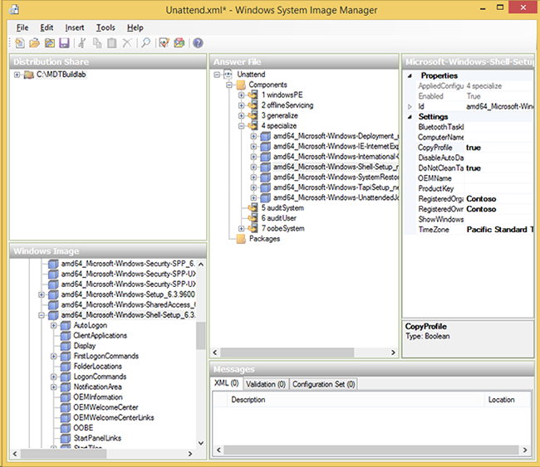
How to create the - Answer file
You must download the Windows Assessment and Deployment Kit (ADK) from: https://go.microsoft.com/fwlink/?linkid=2243390
Then you must install it and run it
The ADK has a GUI to help you select what you wish to keep in your generalized version of Windows

Slide 27
Assignment 4- Practical Examination - deliverables
Part 1 (3%): Creating a Windows 10 VM access the audit mode and connect it to the internet.
Part 2 (6%): Customize user profile of the PC based on requirements + Creating an Answer file + Running SysPrep
Part 3 (5%): Saving the wim file image + creating the custom ISO file
Demo (5%)

Slide 28
Before and After running Sysprep
After Sysprep:
Before Sysprep:
Windows Instllation
ISO
Generalized Windows Installation
ISO
C drive (VHDX)
CD/DVD drive (.ISO)
D drive (additional VHDX)
C drive (VHDX)
CD/DVD drive
D drive (additional VHDX)
The System Preparation Tool is a built-in tool which is used to duplicate, test and deliver new installations of Windows.
One of the procedures sysprep did was to remove the security identifier so that your current installation of Windows 11 can be re-used on different machines while preserving your software and preferences.
The Generalized Windows Installation is currently inside the VHDX and still cannot be used on another PC.

Slide 29
Saving the Wim image
After DISM capture Image:
Capture Dir
Reference Image
Custom Image
Generalized Windows Installation
ISO
C drive (VHDX)
CD/DVD drive
D drive (additional VHDX)
The Deployment Image Servicing and Management (DISM) is another command line tool that allows you to “capture” the customized image and move it to a different location.
To do that we want to run the /capture-image command inside a command prompt. This will create our own install.wim file.
dism /capture-image
/imagefile:E:\install.wim /capturedir:C:\ /ScratchDir:D:\Scratch
/name:"LASTNAME_Win1EDx64"
/compress:maximum
/checkintegrity
/verify
/bootable

Slide 30
Saving the Wim image
After DISM capture Image:
Capture Dir
Reference Image
Custom Image
Generalized Windows Installation
ISO
C drive (VHDX)
CD/DVD drive
D drive (additional VHDX)
dism /capture-image
/imagefile:E:\install.wim /capturedir:C:\ /ScratchDir:D:\Scratch
/name:"LASTNAME_Win1EDx64"
/compress:maximum
/checkintegrity
/verify
/bootable
All we have on our host machine to show for our work is a single .vhdx file
How do we extract a .wim file from the C:\ drive?
We need to be inside the VM but outside of Windows.
We can use WinRE or WinPE

Slide 31
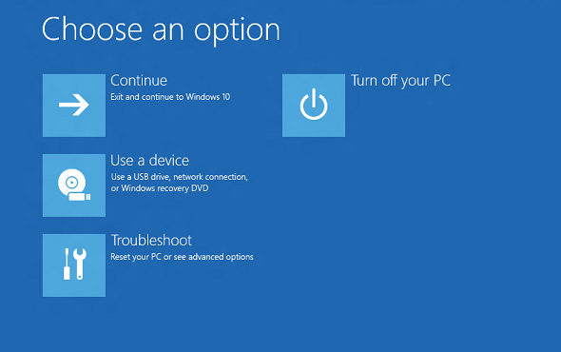
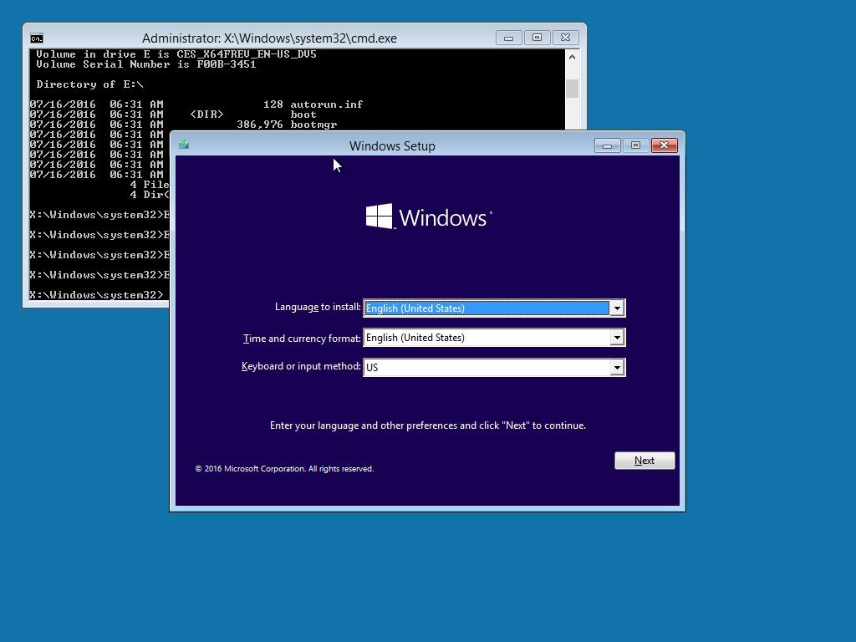
WinRE and WinPE – Reminder Lecture 10
Windows Recovery Environement
Windows Pre-Installation Environment
WinRE is based on WinPE allows you to run diagnostic tools and troubleshoot issues related to Windows.
Small OS used to install or repair Windows
Allows you to run diskpart to view your partitions
Allows you to run DISM to capture the C drive image.
Recover data from hard drive if it’s not bootable

Slide 32
Saving the Wim image
Set the Boot order to start from the Windows 11 ISO (provided in PART 1)
At the installer PROMPT
Press SHIFT + F10
This will open a Recovery Console command Prompt
You will need to use DISKPART to check that your partitions have the correctly assigned letters
Using the command list vol
Then you will enter the DISM command →
dism /capture-image
/imagefile:E:\install.wim /capturedir:C:\ /ScratchDir:E:\Scratch
/name:"LASTNAME_Win11EDx64"
/compress:maximum
/checkintegrity
/verify
/bootable
Takes 10 mins

Slide 33
Assignment 4- Practical Examination - deliverables
Part 1 (3%): Creating a Windows 10 VM access the audit mode and connect it to the internet.
Part 2 (6%): Customize user profile of the PC based on requirements + Creating an Answer file + Running SysPrep
Part 3 (5%): Saving the wim file image + creating the custom ISO file
Demo (5%)

Slide 34
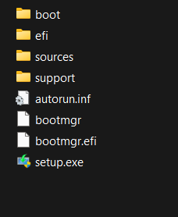
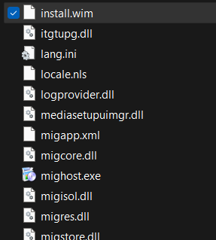
Creating the ISO image
To be able to use this install.wim, it needs to be created and saved inside inside a Windows 11 ISO image.
From within the VM
You will go through the OOBE steps, then
Once Windows is loaded
Copy the ISO file into the created VHDX (D drive)
Then we will simply replace the install.wim file with the custom install.wim
To be replaced with your custom .wim
Content of the ISO file

Slide 35
Q & A
Notes:
In Slide Show mode, click the arrow to enter the PowerPoint Getting Started Center.

